Slide 1

Battle, Conflict and Events
Study five past monarchs through time

Slide 2
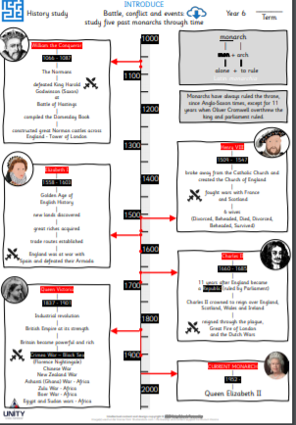

Slide 3
Norman
Put these in order
Stone-Age
Roman
Viking
Iron-Age
Victorian

Slide 4
Norman
Put these in order
Stone-Age
Iron-Age
Roman
Viking
Victorian

Slide 5
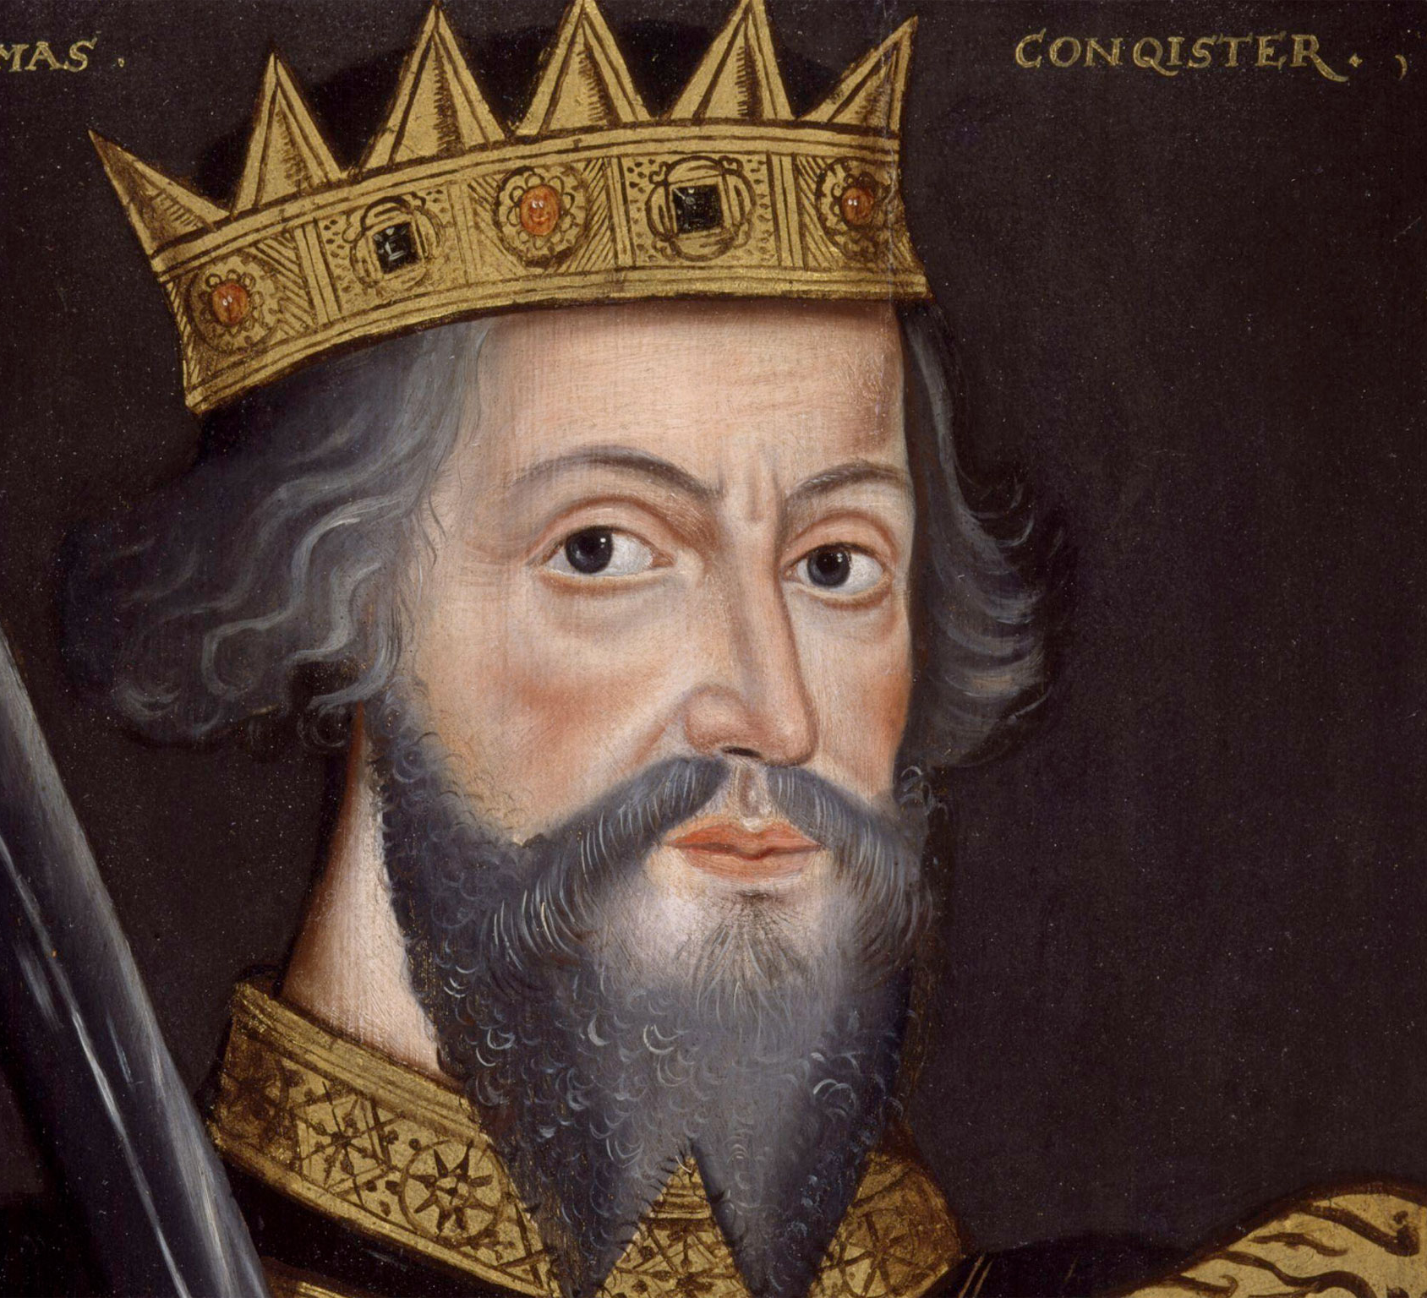
William I
William the Conqueror

Slide 6
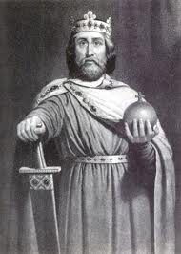
How is William I remembered?
What legacy did he leave?

Slide 7
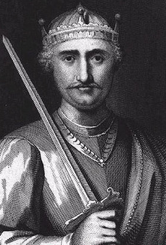
The first Norman king of England. He reigned from 1066 until his death in 1087.
*Norman: From France

Slide 8
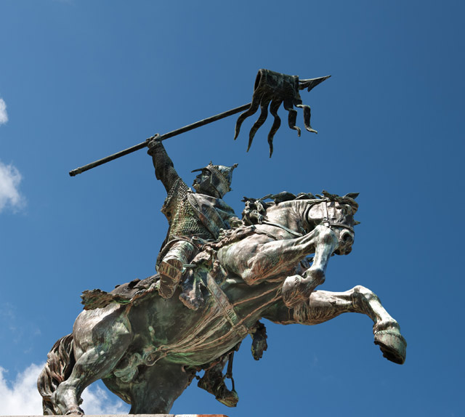
The Battle of Hastings: Click here
The Battle of Hastings: Click here

Slide 9
What was the name of the battle?
Who won?

Slide 10
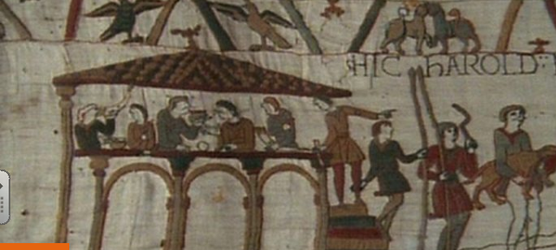
The Bayeux Tapestry
The story of the battle. Click here

Slide 11
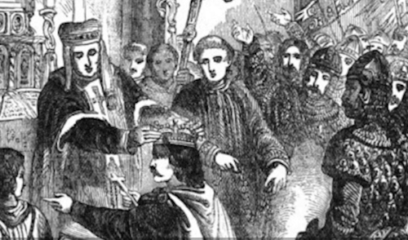
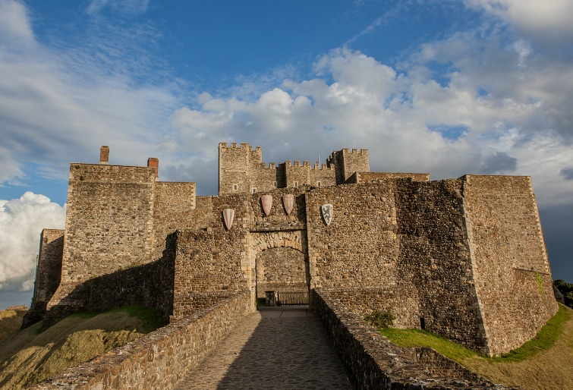
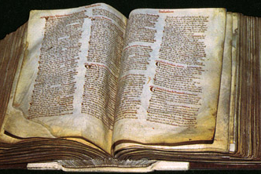
So, William has won the battle what next?
Westminster Abbey
Norman Forts
The Domesday Book

Slide 12
The Domesday Survey
Great Survey
Record of belongings so that taxes can be calculated
Begun 1085 and completed in 1086

Slide 13
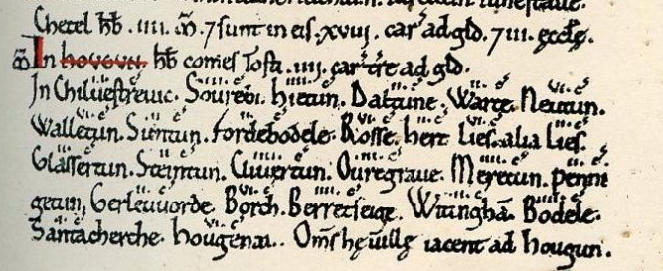
The Domesday Book

Slide 14
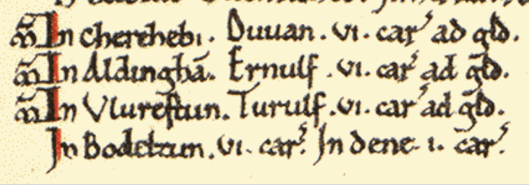
The Domesday Book

Slide 15
What was the book called?
When was it started and finished?
What did it record and why?

Slide 16
Thursday 18th June
OBJ: What was the legacy of William I?
Write a short explanation of William’s legacy
  The Bayeux Tapestry
  The Domesday Book
Choose a sequence of events, life in lockdown for example, and draw or paint your own ‘tapestry’.

Slide 17
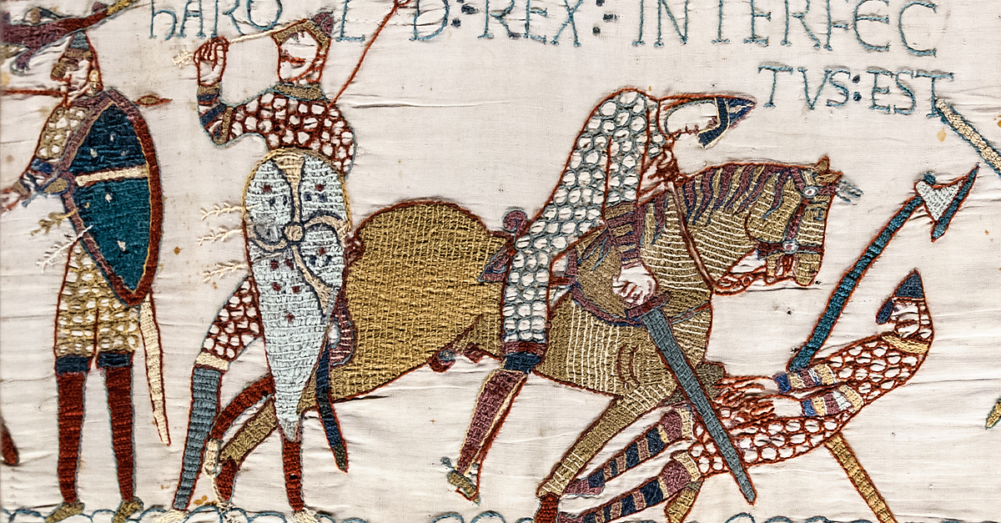

Slide 18
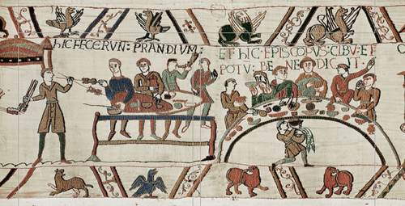

Slide 19
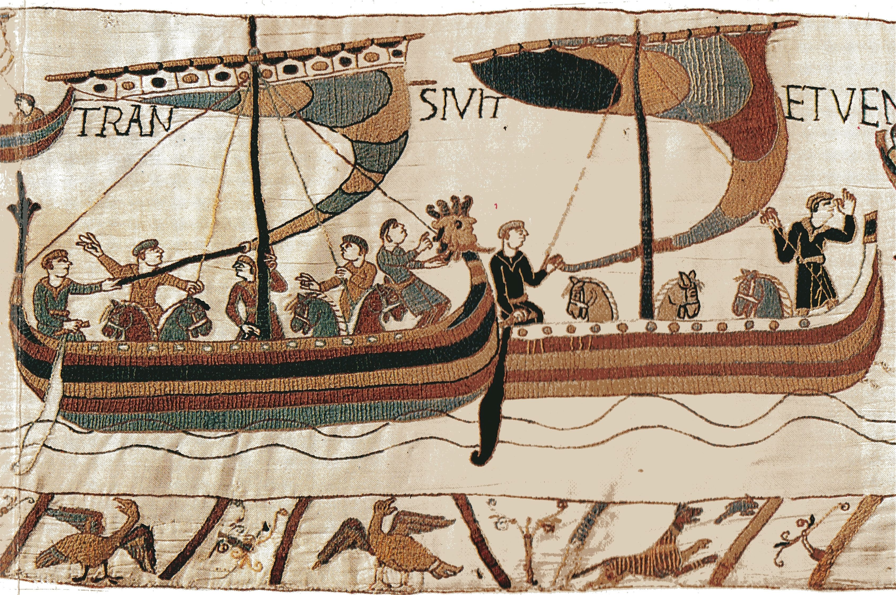

Slide 20
Quick quiz
What was the name of the Battle where Harold was beaten?
What was the tapestry called?
What does Domesday mean?

