Slide 1
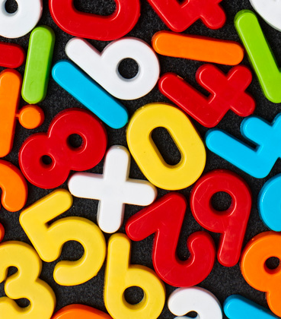
Maths
Tuesday Week 2

Slide 2
Counting

Slide 3
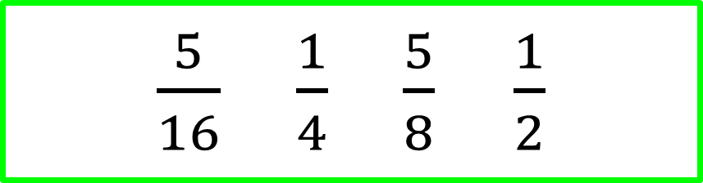
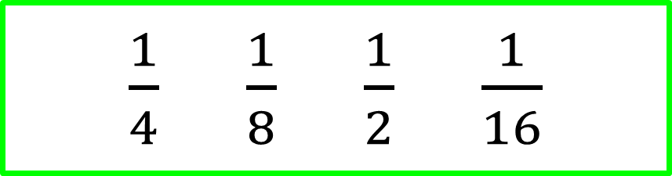
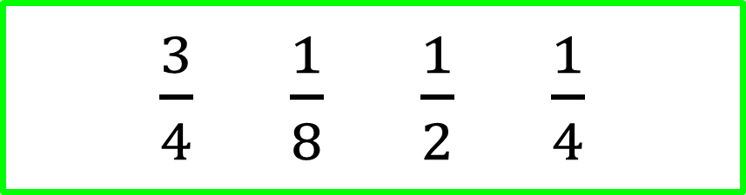
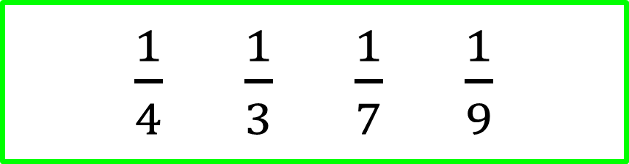
Order these fractions from smallest to largest.
$\frac{1}{4}$ $\frac{1}{8}$ $\frac{1}{2}$ $\frac{1}{16}$
$\frac{3}{4}$ $\frac{1}{8}$ $\frac{1}{2}$ $\frac{1}{4}$
$\frac{1}{4}$ $\frac{1}{3}$ $\frac{1}{7}$ $\frac{1}{9}$
$\frac{5}{16}$ $\frac{1}{4}$ $\frac{5}{8} \frac{1}{2}$

Slide 4
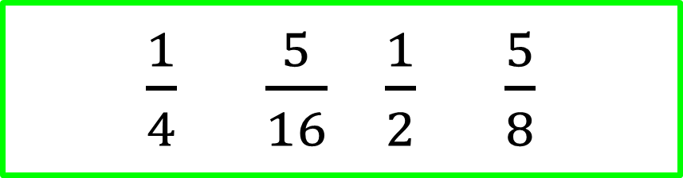

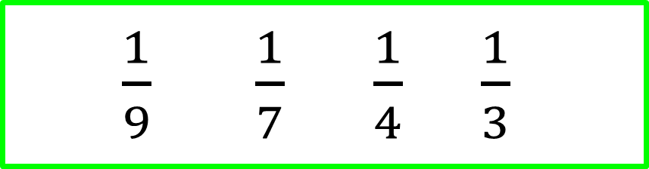
$\frac{1}{16} \frac{1}{ 8} \frac{1}{4}$ $\frac{1}{2}$
$\frac{3}{4}$ $\frac{1}{8}$ $\frac{1}{2}$ $\frac{1}{4}$
$\frac{1}{9} \frac{1}{7} \frac{1}{4}$ $\frac{1}{3}$
$\frac{1}{4}$ $\frac{5}{16}$ $\frac{1}{2}$ $\frac{5}{8}$

Slide 5
Learn-its

Slide 6
9 + 4
9 + 2
9 + 3
9 + 5
5 + 9
7 + 9
3 + 9
4 + 9
3 + 9 + 6
9 + 4 + 5
9 + 7 + 1
6 + 9 + 8
9 + 2 + 8
9 + 3 + 4
5 + 9 + 2
9 + 2 + 6
30 + 9 + 70
9 + 4 + 50 + 50
9 + 60 + 1 + 40
6 + 9 + 8 + 1 + 2
9 + 2 + 80 + 20
9 + 3 + 40 + 60
50 + 90 + 10
9 + 20 + 6 + 80

Slide 7
9 + 4=13
9 + 2=11
9 + 3=12
9 + 5=14
5 + 9=14
7 + 9=16
3 + 9=12
4 + 9=13
3 + 9 + 6=18
9 + 4 + 5=18
9 + 7 + 1=17
6 + 9 + 8=23
9 + 2 + 8=19
9 + 3 + 4=16
5 + 9 + 2=16
9 + 2 + 6=17
30 + 9 + 70=109
9 + 4 + 50 + 50=113
9 + 60 + 1 + 40=110
6 + 9 + 8 + 1 + 2=26
9 + 2 + 80 + 20=111
9 + 3 + 40 + 60=112
50 + 90 + 10=150
9 + 20 + 6 + 80=115

Slide 8
It’s nothing new

Slide 9
a = 45
b = ?
a
b

Slide 10
a = 88
b = ?
b
a

Slide 11
a = 10
b = ?
b

Slide 12
Line Graphs

Slide 13
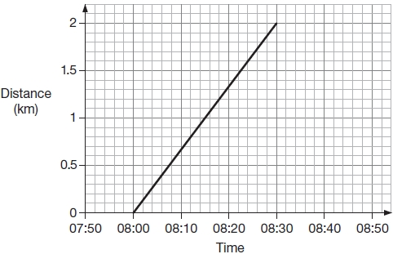
Q1.
Alfie and his brother walked from home to their school.
Their school is 2 kilometres from home.
The graph shows information about Alfie’s journey.
(a) How does the graph show that Alfie walked at a constant speed for all of his journey?
______________________________________________________________
1 mark

Slide 14
(b) Alfie’s brother left home 10 minutes before Alfie.
He arrived at school 20 minutes after Alfie.
He walked at a constant speed for all of his journey.
At what time did Alfie overtake his brother?
1 mark

Slide 15
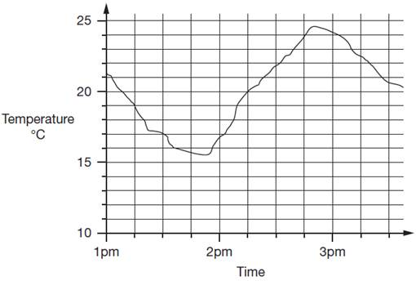



Estimate the temperature at 3:15pm.
Estimate the time when the temperature was highest.
How much did the temperature change from 2pm to 2:30pm? Give your answer to the nearest degree.

Slide 16
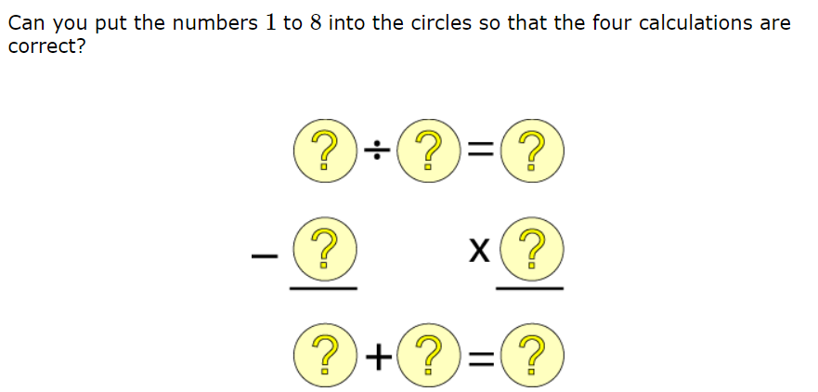
Finished already?
You can only use each digit once.

Slide 17
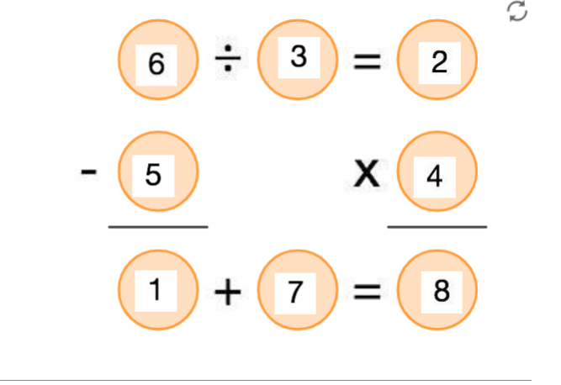
Finished already?

