Slide 1
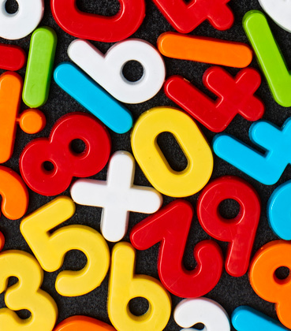
Maths Autumn
Week 3

Slide 2
Calculation

Slide 3
11.06.2020
OBJ: Missing numbers addition Straightforward
+24
32
5_
+84
1_
97
+_3
1_
55
+52
_2
9_
+63
1_
7_
+43
94
_3_

Slide 4
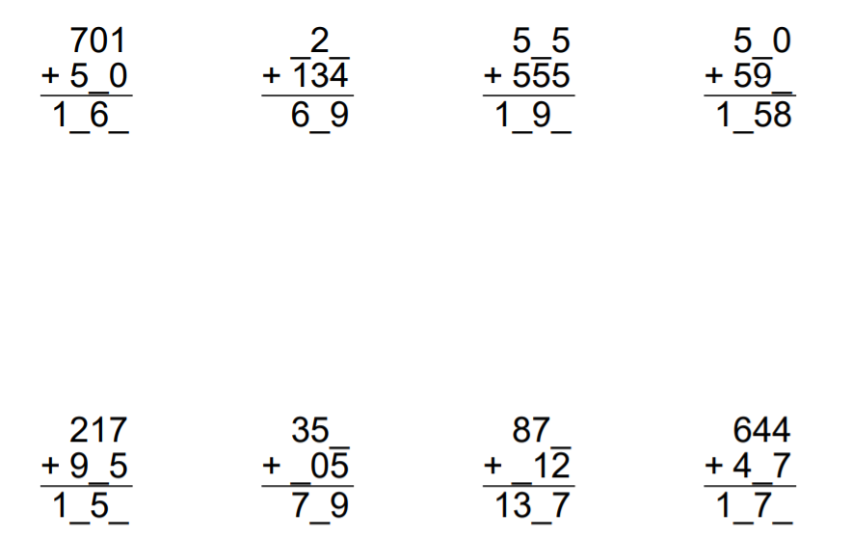
11.06.2020
OBJ: Missing numbers addition Tricky

Slide 5
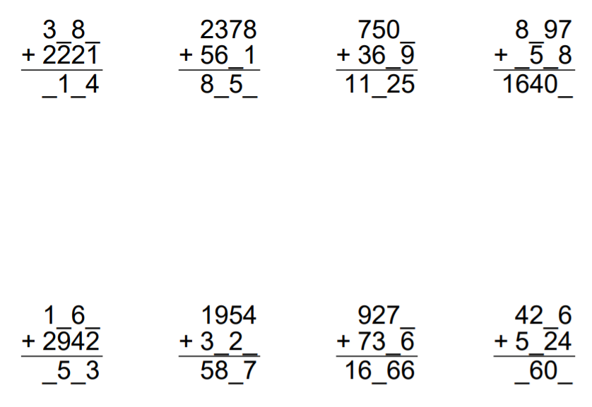
11.06.2020
OBJ: Missing numbers addition Challenge

Slide 6
Protractors

Slide 7
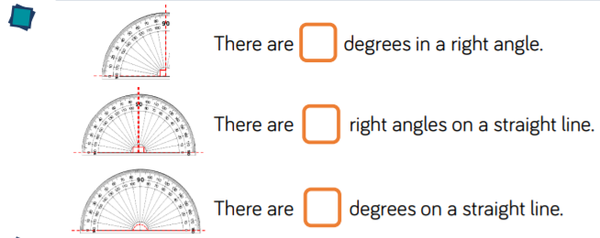

Slide 8
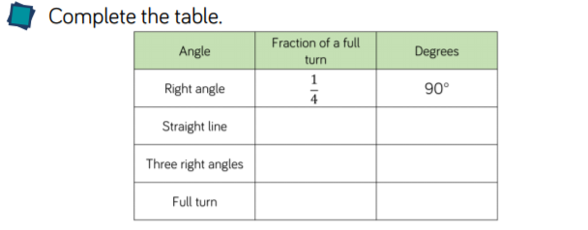

Slide 9
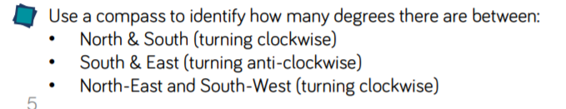
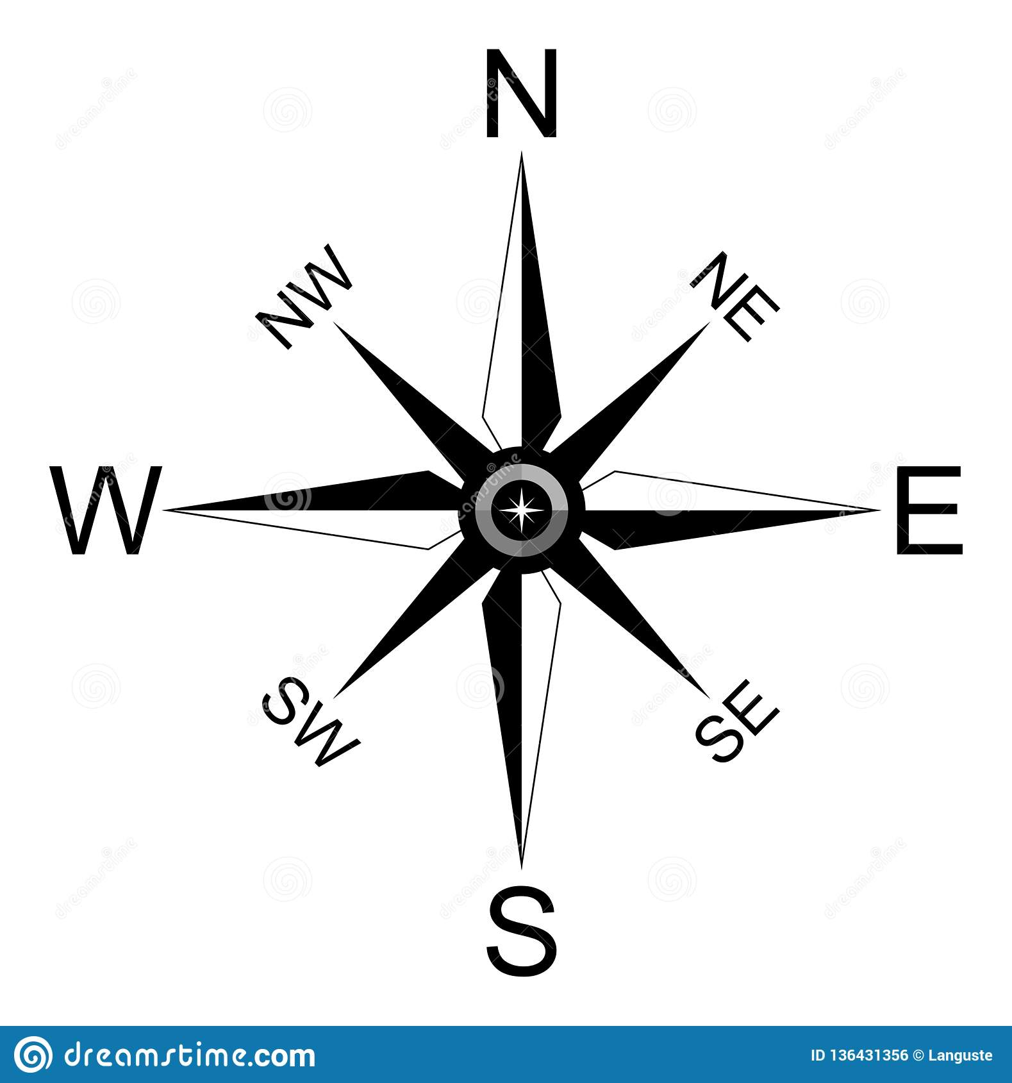

Slide 10
11.06.2020
OBJ: Measuring and Calculating Angles 2

