Slide 1
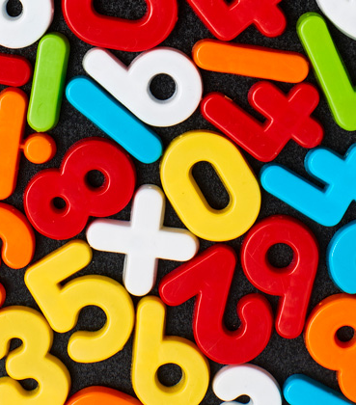
Maths Summer Week 1
Friday

Slide 2
Counting

Slide 3


Get your whiteboards ready!!

Slide 4
How much has each number increased by?
23 33 43
175 200 225
0.3 0.6 0.9
45 90 135
64 82 100

Slide 5
Learn-its

Slide 6
Use those tables facts!
Write down the following multiples of 8:
6th
3rd
1st
9th
7th
64 ÷ 8 =
48 ÷ 8
72 ÷ 8
728 ÷ 8
3280 ÷ 8

Slide 7
Use those tables facts!
Write down the following multiples of 8:
6th = 48
3rd = 24
1st = 8
9th = 72
7th = 56
64 ÷ 8 = 8
48 ÷ 8 =6
72 ÷ 8 = 9
728 ÷ 8= 91
3280 ÷ 8 = 410

Slide 8
It’s nothing new

Slide 9
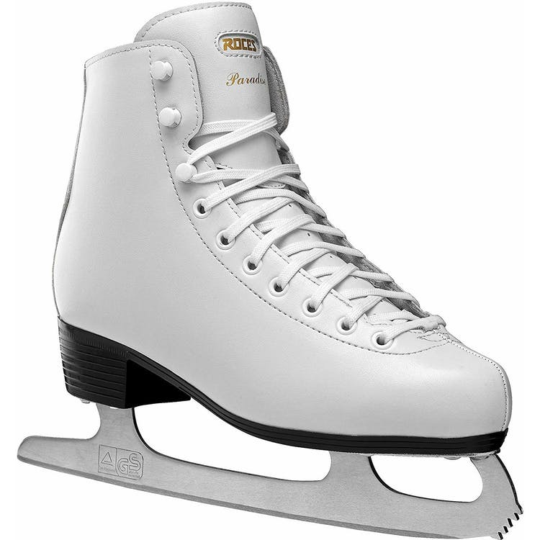
Multiplying by 10, 100 and 1000
These skates cost £79.94.
What is the cost for:
10 pairs
100 pairs
1000 pairs
2 pairs
20 pairs
For orders over 1000 pairs, the company gives a reduction of 50p per pair. What is the cost of 2000 pairs of skates?

Slide 10
Multiplying by 10, 100 and 1000
These skates cost £79.94.
What is the cost for:
10 pairs £799.40
100 pairs £7,994.0
1000 pairs £79,940.00
2 pairs £159.88
20 pairs £1598.80
For orders over 1000 pairs, the company gives a reduction of 50p per pair. What is the cost of 2000 pairs of skates?

Slide 11
Calculation

Slide 12
Straightforward
354 - 215=
894 - 386=
£8.35 - £2.57=
4.65 – 1.83
7.19 – 5.27
Tricky
583 - 277=
£3.72 – £2.76=
17.58 - 2.65=
45,821 – 23,733
23.15 – 12.8
7.03 – 2.55
Challenge
45,231 – 12,673=
8.3 – 1.27=
£1258 - £90.60=
1519 + ___ = 3480
What is the change from £12.67 if I spend £3.78?

Slide 13
Straightforward
354 - 215=139
894 - 386=508
£8.35 - £2.57=£5.78
4.65 – 1.83=2.82
7.19 – 5.27=1.92
Tricky
583 - 277=306
£3.72 – £2.76=£0.96
17.58 - 2.65=14.93
45,821 – 23,733=22,088
23.15 – 12.8=10.35
7.03 – 2.55=4.48
Challenge
45,231 – 12,673=32,558
8.3 – 1.27=7.03
£1258 - £90.60=£1,167.40
1519 + 1961 = 3480
What is the change from £12.67 if I spend £3.78?£8.89

