Slide 1

Maths
Tuesday Week 6

Slide 2
Counting

Slide 3
Negative numbers
What is 10 less than….
3
7
15
6
-1
What is 15 less than….
14
6
12
-5
9
What is 27 less than…
7
-32
17
21
-4

Slide 4
Negative numbers
What is 10 less than….
-7
-3
5
-4
-11
What is 15 less than….
-1
-9
-3
-20
-6
What is 27 less than…
-20
-59
-10
-6
-31

Slide 5
Learn-its

Slide 6
15 ÷ 3
18 ÷ 3
36 ÷ 4
42 ÷ 6
55 ÷ 5
60 ÷ 5
36 ÷ 6
110 ÷ 10
27 ÷ 3
54 ÷ 6
32 ÷ 8
63 ÷ 7
72 ÷ 9
40 ÷ 8
56 ÷ 7
88 ÷ 8
45 ÷ 15
162 ÷ 2
324 ÷ 4
426 ÷ 6
555 ÷ 5
729 ÷ 9
819 ÷ 9
567 ÷ 7

Slide 7
It’s nothing new

Slide 8
50% of 80 = 40
What is 100% of 80?
What is 25% of 80?
50% of 120 = 60
What is 25% of 120?
What is 75% of 120?
10% of 190 = 19
What is 20% of 190?
What is 50% of 190?
What is 80% of 190?
What is 20% of 670?
What is 50% of 650?
What is 70% of 190?
If 25% of a number is 12, what is 100%?

Slide 9
Calculation
Division

Slide 10
36 ÷ 6
624 ÷ 6
47 ÷ 6
656 ÷ 16

Slide 11
36 ÷ 6=6
624 ÷ 6=104
47 ÷ 6= 7r5
656 ÷ 16=41

Slide 12
81 ÷ 7
791 ÷ 7
756 ÷ 7
1525.5 ÷ 27

Slide 13
81 ÷ 7= 11r4
791 ÷ 7=113
756 ÷ 7=108
1525.5 ÷ 27=56.5

Slide 14
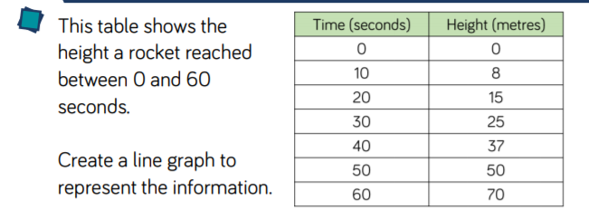


Slide 15
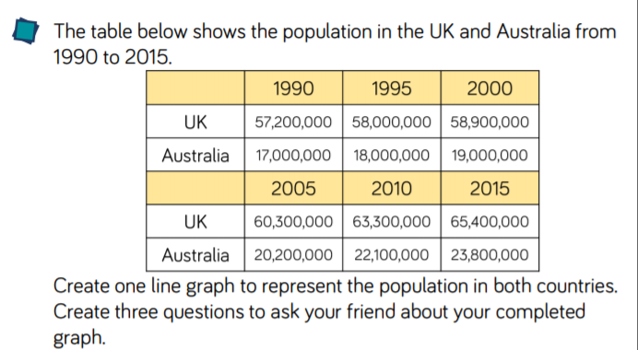
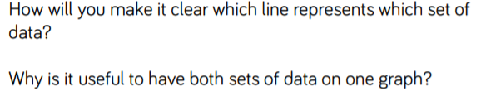

Slide 16
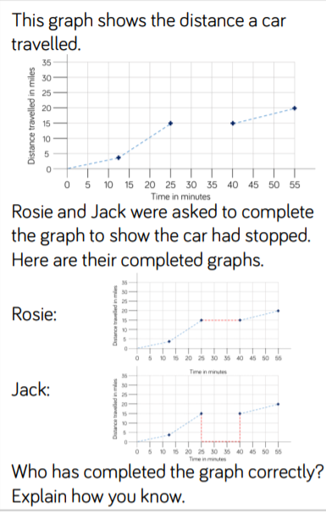
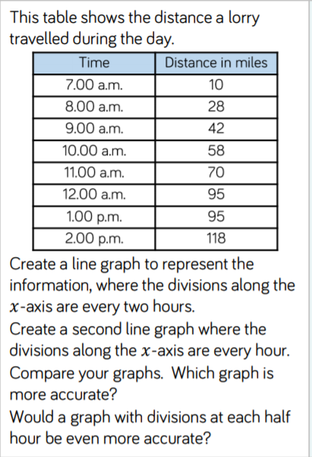

Slide 17
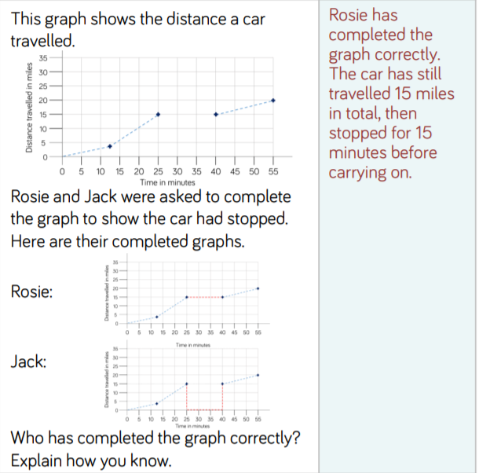
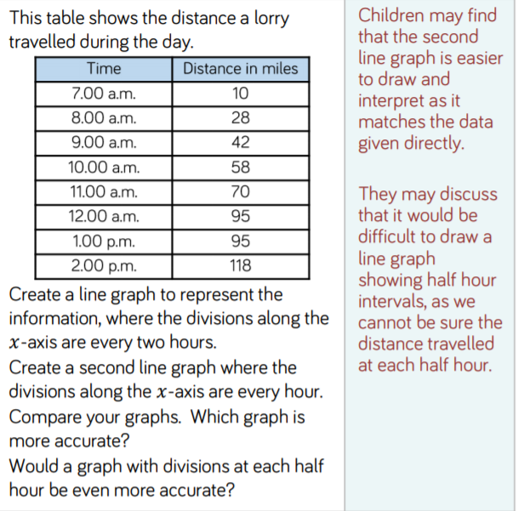

Slide 18




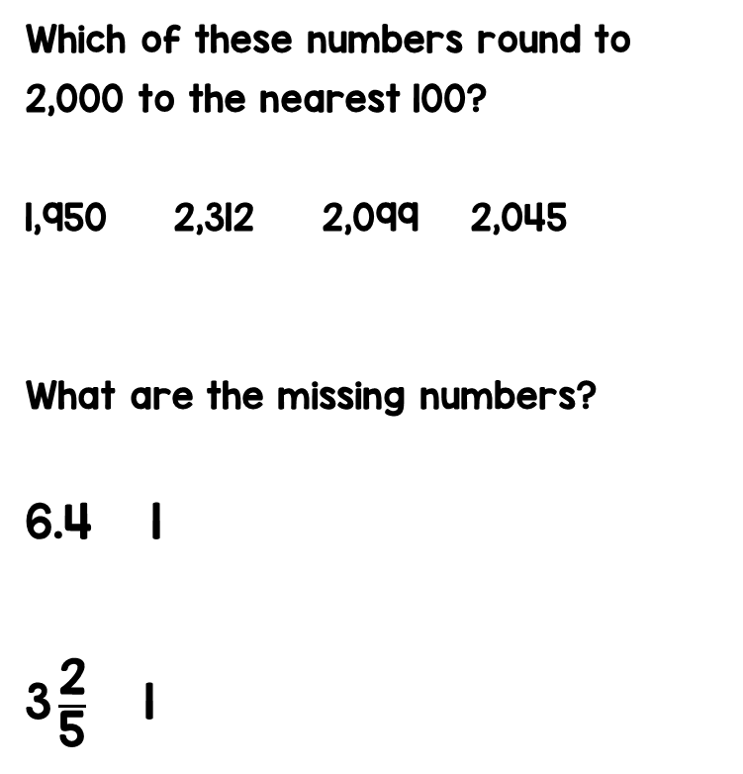

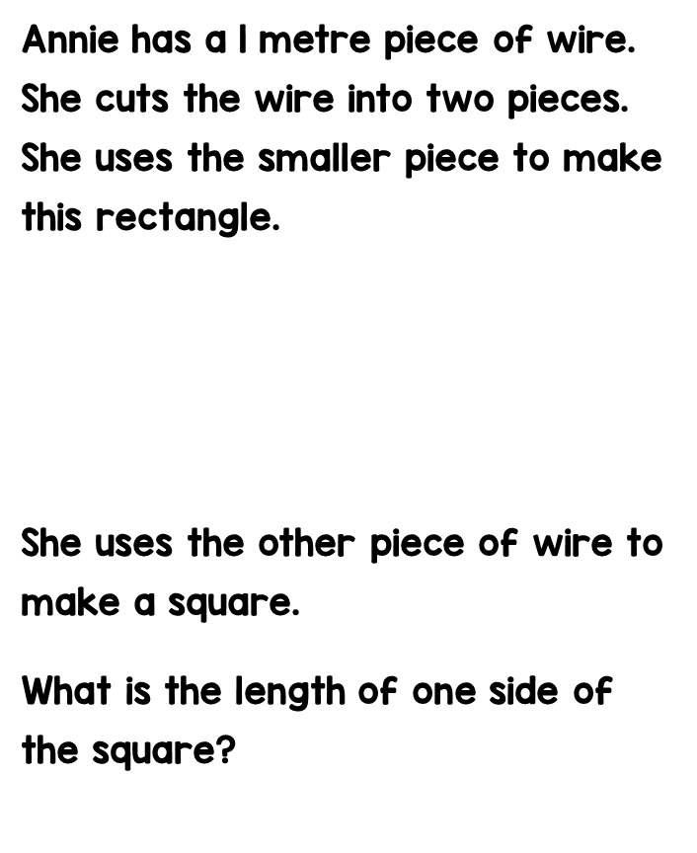
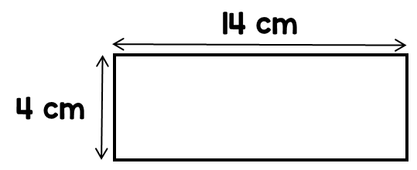

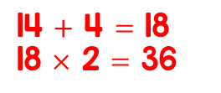


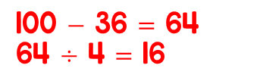







$$=$$
$$+$$
$$=$$
$$+$$

Slide 19


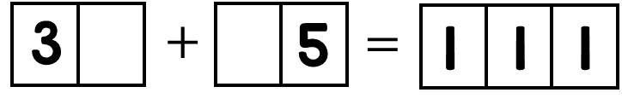


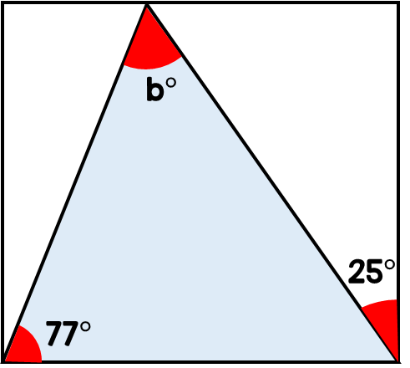




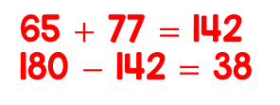


What are the missing digits?
Annie and Ron each think of a number.
The product of their numbers is 762
Work out Ron’s number.
Find the size of angle b.
I’m thinking of the number 6

