Slide 1
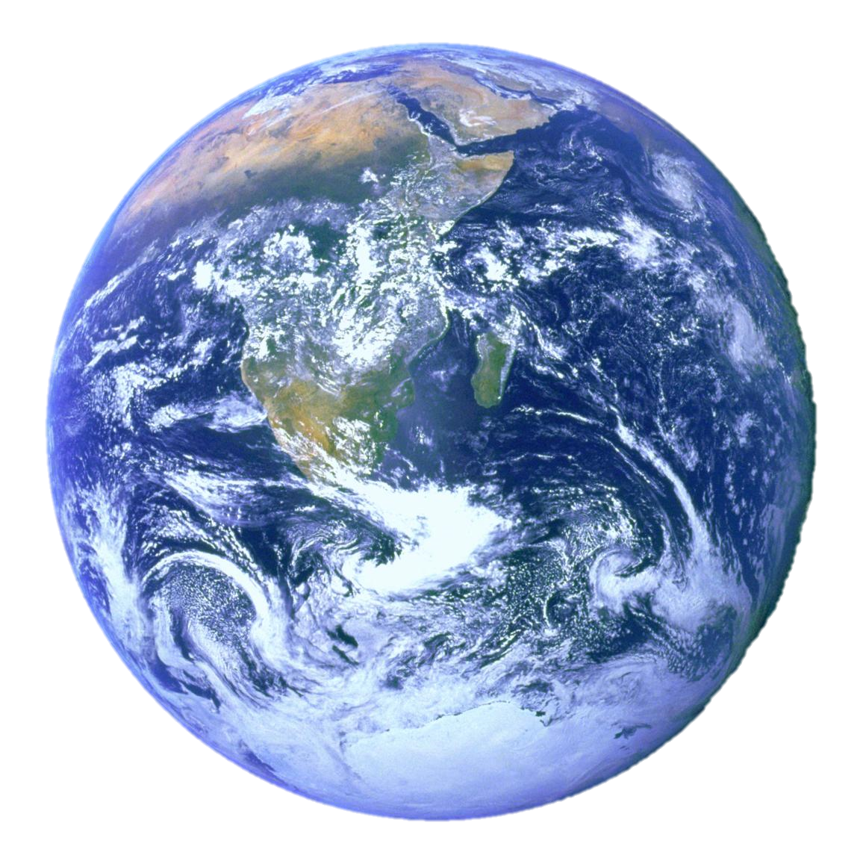

Slide 2
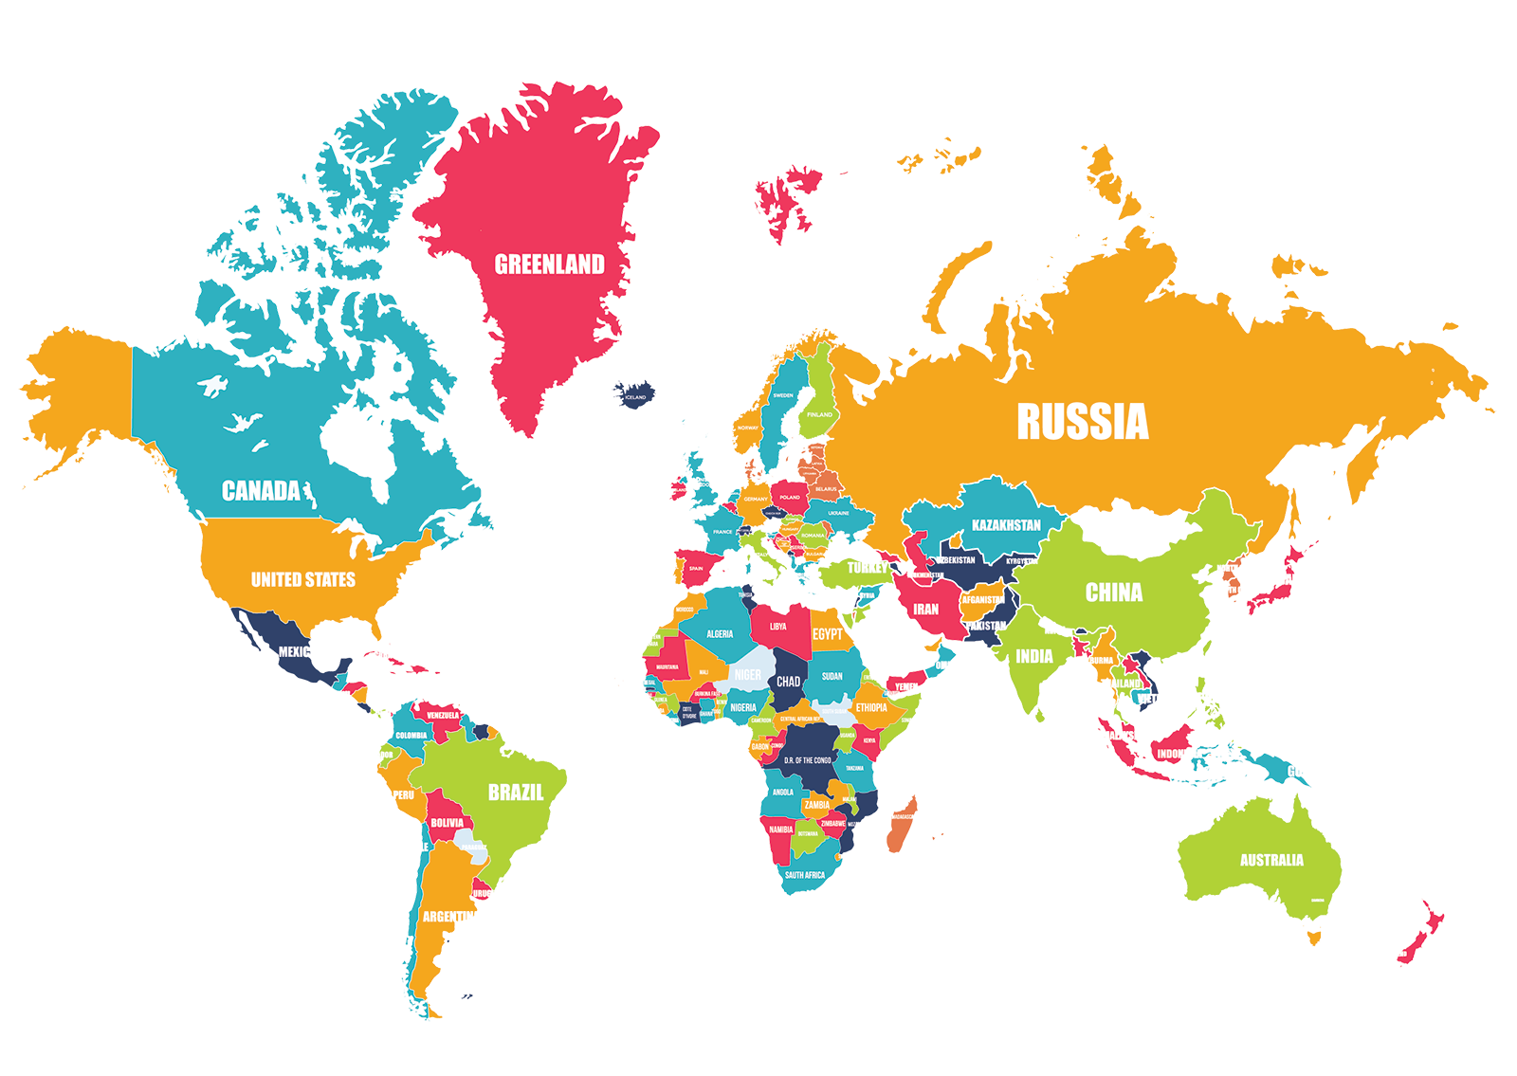

Slide 3
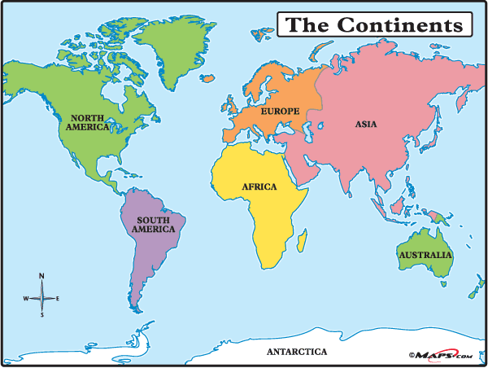

Slide 11
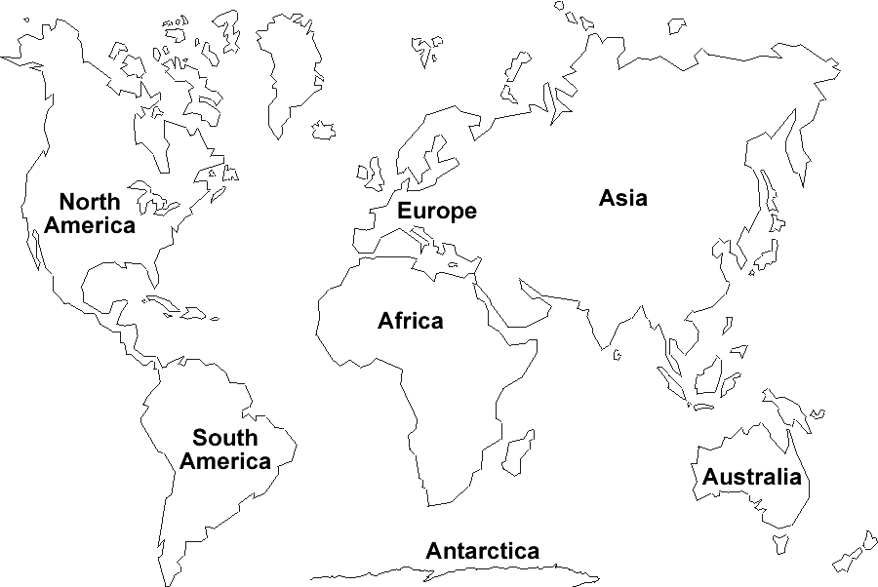
Monday 8th June Obj: I can name and locate world’s continents Name ____________________

Slide 12
Antarctica
Europe
North
America
Asia
Africa
South
America
Australia

