Slide 1
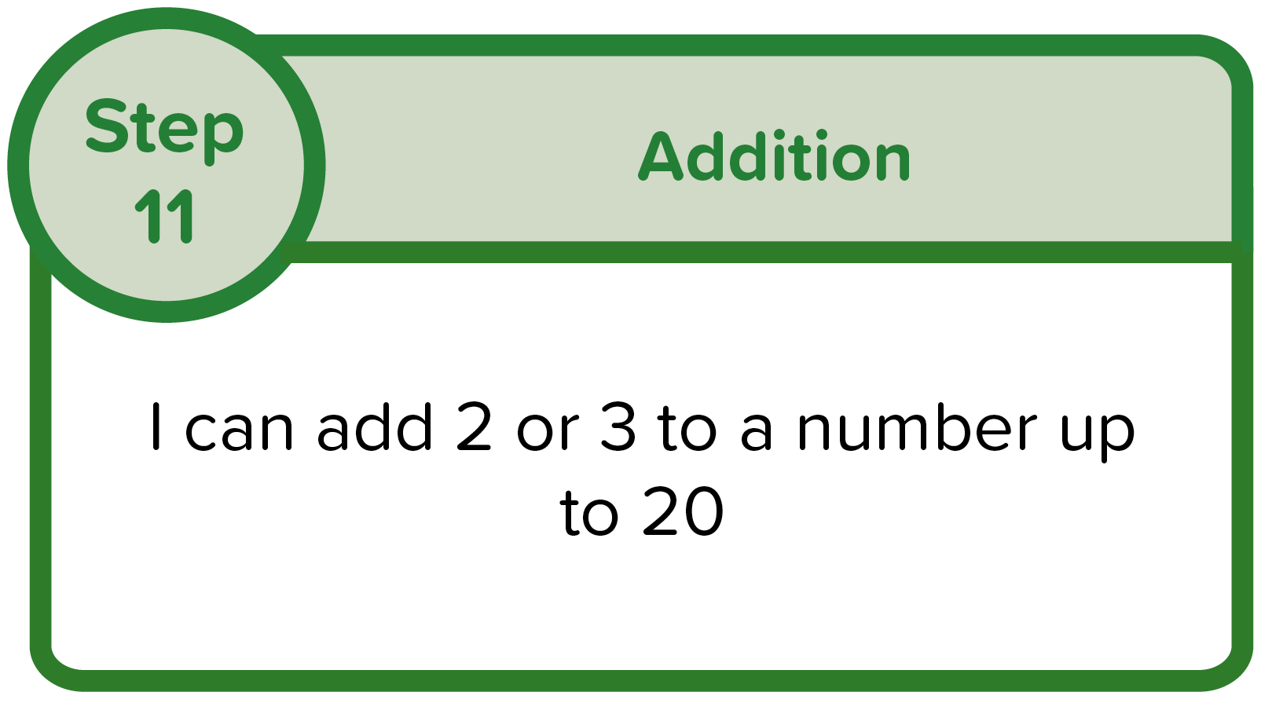

Remember To:
find the starting number
count on the right amount, one jump for each number
see where you have landed
Example 1

Slide 2

Get your whiteboards ready!

Slide 3
Remember To:
12 + 2 =
find the starting number
count on the right amount, one jump for each number
see where you have landed
1
2
3
4
5
6
7
8
9
11
12
13
14
15
16
17
18
19
0
10
20

Slide 4

Remember To:
12 + 2 =
14
find the starting number
count on the right amount, one jump for each number
see where you have landed
14
Count on TWO
1
2
3
4
5
6
7
8
9
11
12
13
14
15
16
17
18
19
0
10
20

Slide 5
Remember To:
12 + 2 =
14
find the starting number
count on the right amount, one jump for each number
see where you have landed
14
11 | 12 | 13 | 14 | 15 | 16 | 17 | 18 | 19 | 20
1 | 2 | 3 | 4 | 5 | 6 | 7 | 8 | 9 | 10

Slide 6
Remember To:
12 + 2 =
14
find the starting number
count on the right amount, one jump for each number
see where you have landed
14
11 | 12 | 13 | 14 | 15 | 16 | 17 | 18 | 19 | 20
1 | 2 | 3 | 4 | 5 | 6 | 7 | 8 | 9 | 10

Slide 7
Remember To:
12 + 2 =
14
find the starting number
count on the right amount, one jump for each number
see where you have landed
14
11 | 12 | 13 | 14 | 15 | 16 | 17 | 18 | 19 | 20
1 | 2 | 3 | 4 | 5 | 6 | 7 | 8 | 9 | 10

Slide 8
Remember To:
find the starting number
count on the right amount, one jump for each number
see where you have landed
Example 2

Slide 9
Get your whiteboards ready!

Slide 10
Remember To:
14 + 3 =
find the starting number
count on the right amount, one jump for each number
see where you have landed
1
2
3
4
5
6
7
8
9
11
12
13
14
15
16
17
18
19
0
10
20

Slide 11
Remember To:
14 + 3 =
17
find the starting number
count on the right amount, one jump for each number
see where you have landed
17
Count on THREE
1
2
3
4
5
6
7
8
9
11
12
13
14
15
16
17
18
19
0
10
20

Slide 12
Remember To:
14 + 3 =
17
find the starting number
count on the right amount, one jump for each number
see where you have landed
17
11 | 12 | 13 | 14 | 15 | 16 | 17 | 18 | 19 | 20
1 | 2 | 3 | 4 | 5 | 6 | 7 | 8 | 9 | 10

Slide 13
Remember To:
14 + 3 =
17
find the starting number
count on the right amount, one jump for each number
see where you have landed
17
11 | 12 | 13 | 14 | 15 | 16 | 17 | 18 | 19 | 20
1 | 2 | 3 | 4 | 5 | 6 | 7 | 8 | 9 | 10

Slide 14
Remember To:
14 + 3 =
17
find the starting number
count on the right amount, one jump for each number
see where you have landed
17
11 | 12 | 13 | 14 | 15 | 16 | 17 | 18 | 19 | 20
1 | 2 | 3 | 4 | 5 | 6 | 7 | 8 | 9 | 10

Slide 15
Remember To:
find the starting number
count on the right amount, one jump for each number
see where you have landed
Example 3

Slide 16
Get your whiteboards ready!

Slide 17
Remember To:
17 + 2 =
find the starting number
count on the right amount, one jump for each number
see where you have landed
1
2
3
4
5
6
7
8
9
11
12
13
14
15
16
17
18
19
0
10
20

Slide 18
Remember To:
17 + 2 =
19
find the starting number
count on the right amount, one jump for each number
see where you have landed
19
Count on TWO
1
2
3
4
5
6
7
8
9
11
12
13
14
15
16
17
18
19
0
10
20

Slide 19
Remember To:
17 + 2 =
19
find the starting number
count on the right amount, one jump for each number
see where you have landed
19
11 | 12 | 13 | 14 | 15 | 16 | 17 | 18 | 19 | 20
1 | 2 | 3 | 4 | 5 | 6 | 7 | 8 | 9 | 10

Slide 20
Remember To:
17 + 2 =
19
find the starting number
count on the right amount, one jump for each number
see where you have landed
19
11 | 12 | 13 | 14 | 15 | 16 | 17 | 18 | 19 | 20
1 | 2 | 3 | 4 | 5 | 6 | 7 | 8 | 9 | 10

Slide 21
Remember To:
17 + 2 =
19
find the starting number
count on the right amount, one jump for each number
see where you have landed
19
11 | 12 | 13 | 14 | 15 | 16 | 17 | 18 | 19 | 20
1 | 2 | 3 | 4 | 5 | 6 | 7 | 8 | 9 | 10

