Slide 1
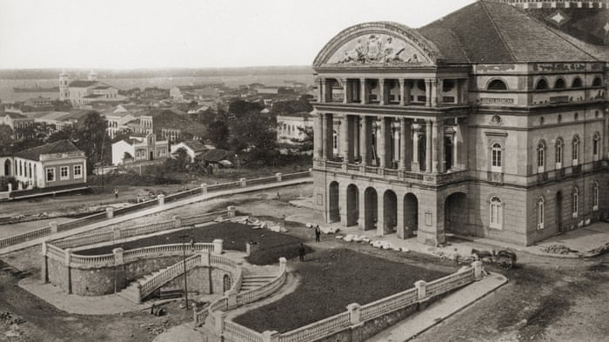
The theatre in Manaus

Slide 2
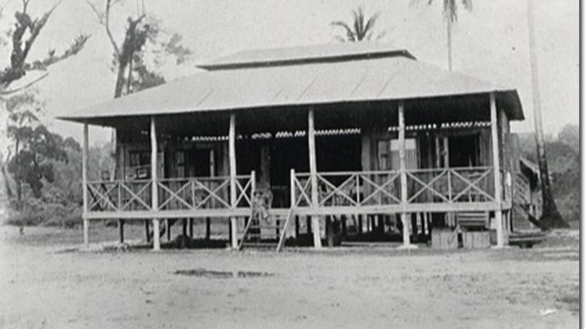

Slide 3
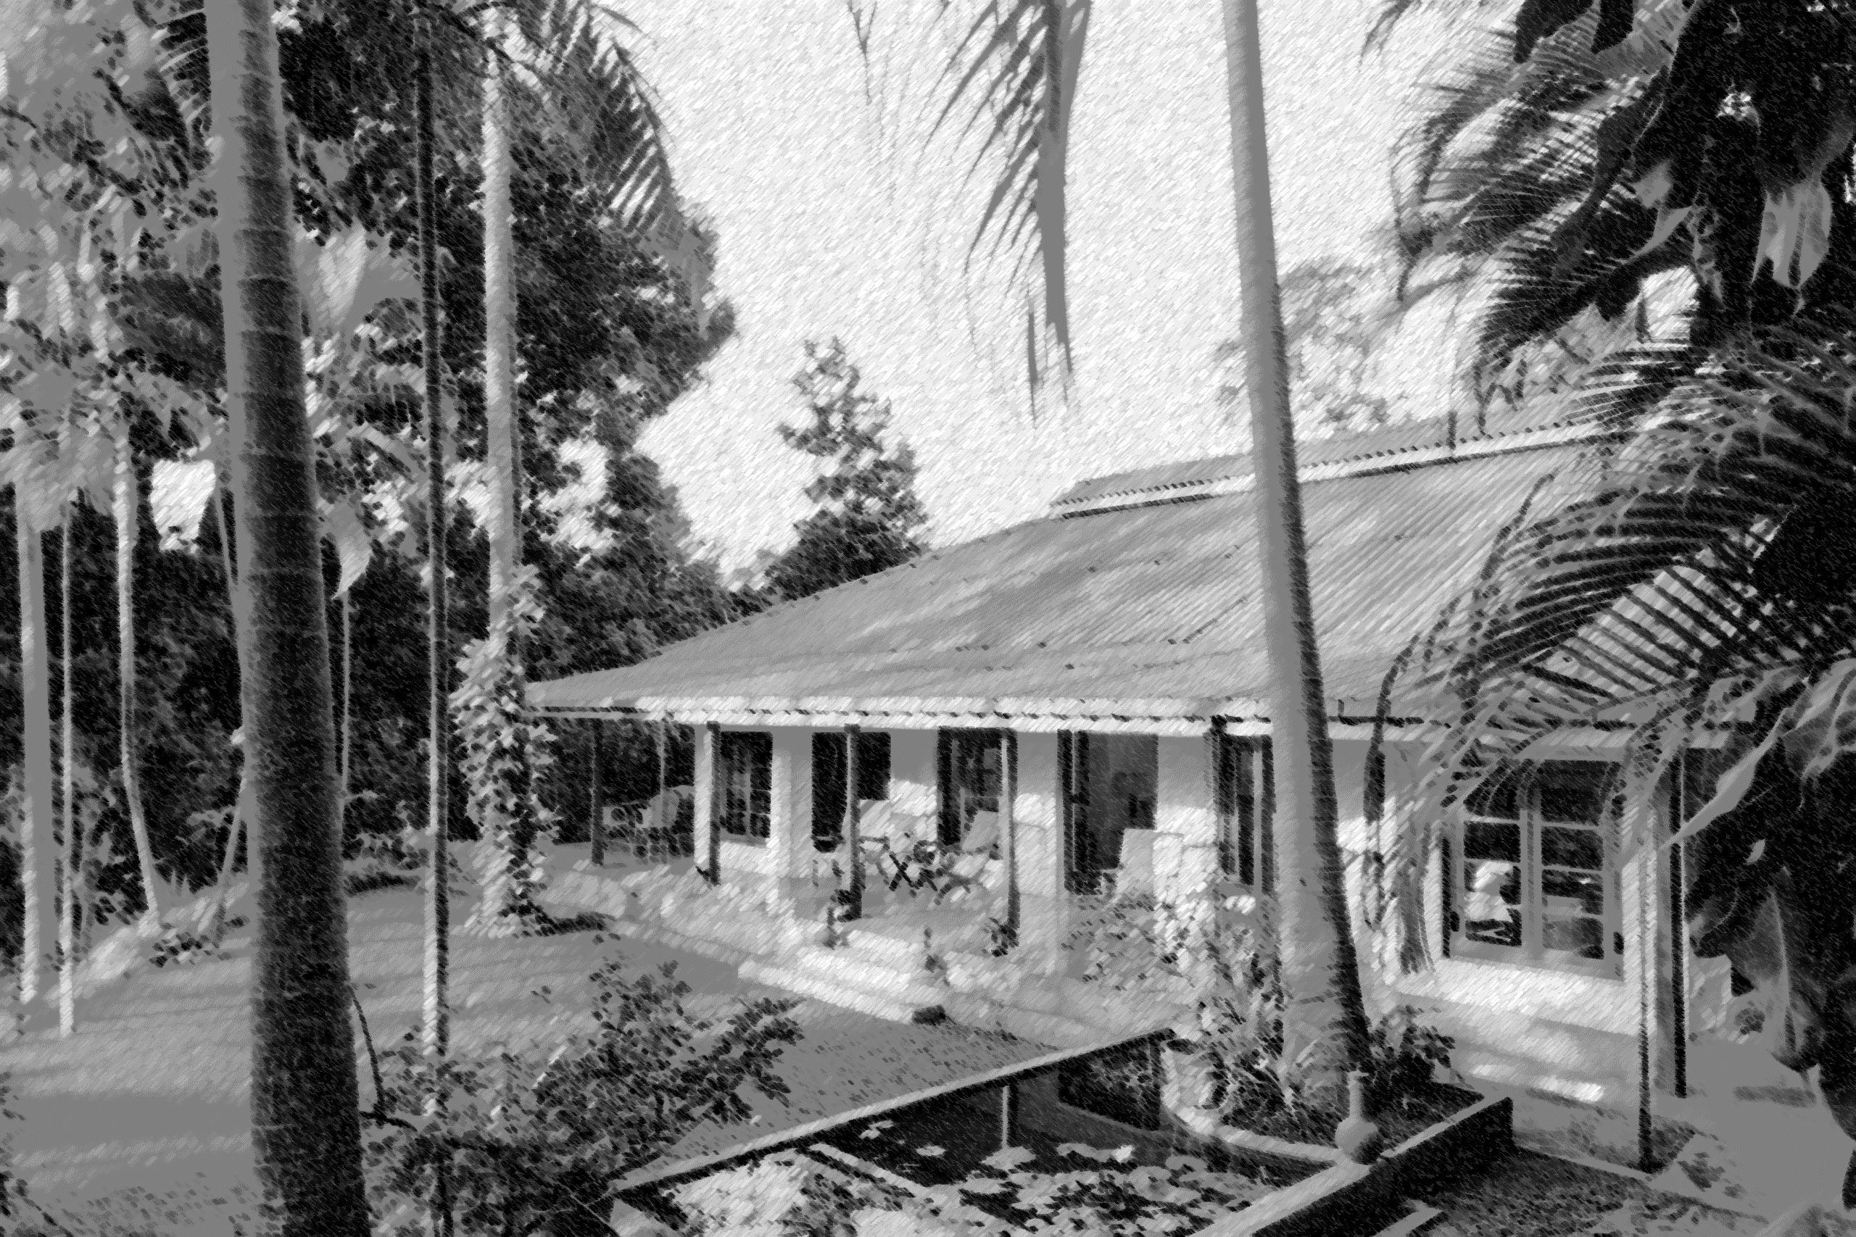

Slide 4
governess guardian liner
Portuguese
Steal some vocabulary

Slide 5
Great green waves loomed up like mountains, the ship rolled and shuddered and pitched.
Steal some vocabulary

Slide 6
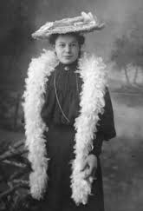
Mrs Goodley’s hair was died a fierce red and she wore layers of scarves and boas and shawls which got caught in things, and Nancy Goodley, who was nineteen, simpered and minced and ordered everyone about.

Slide 7
‘Borrow’ some more from the book.
Steal some vocabulary

Slide 8
Thursday 11th June 2020
OBJ: To write a short letter

Slide 9
Dear Hermione,
Life never turns out as you expect. To think that, when I stepped into that black cab six weeks ago, I was quite terrified of Miss Minton. She looked so severe with her gaunt face and ramrod straight back. (In another letter I will tell you the dreadful tale of Henry Hartington and the broken umbrella.) In fact, strangely, Miss Minton is the best part of the whole adventure so far.
The twins, on the other hand, have not lived up to my expectations. Far from leading a life of excitement and wonder, they seem to resemble the dreadfully dull puddings that this family is so fond of eating! It’s fair to say that my new ‘family’ has not embraced life in South America. They seem desperate to recreate the south of England in the Amazon.
I never thought I would say this, but I do quite miss school. The thought of Miss Banks and her glorious bosom gliding down the corridors like a ship in full sail make me feel quite homesick!
Your confused friend,
Maia

